Slide 1
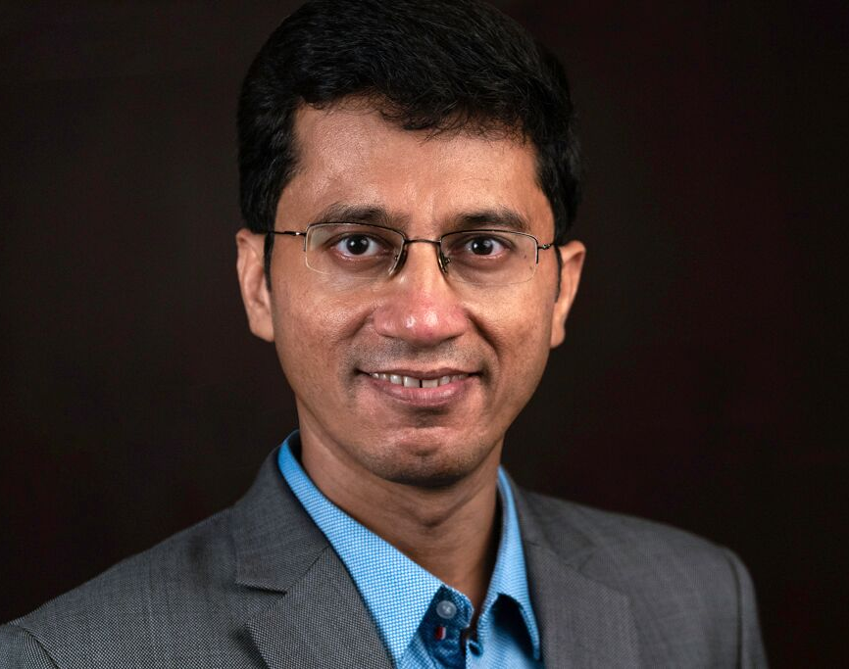
Our speaker today – AMIT Agarwal
Author, SALESPRENEUR®, small is big evangelist
Amit Agarwal is synonymous with Sales and Startups. He has professional selling experience in 23 countries across bootstrapped, Series A, B, C, and D start-ups.
1
He has coined term Salespreneur® and created a new sales strategy Use Case Selling®
2
He is Author of two books
Small is Big &‘The Ultimate Sales Accelerator’
3

